Slide 1
Hard Image Segmentation Using Graph Cuts
Brain Mackwan – 22B0413
Ekansh Ravi Shankar – 22B1032

Slide 2
Introduction and Algorithm

Slide 3
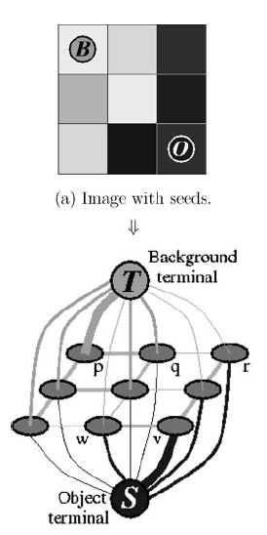
Conversion from Image to Vertices

Slide 4

Assigning Weights to the Edges

Slide 5
Evaluating the Cut

Slide 6

Modifying Hyperparameters for Optimal Results

Slide 7
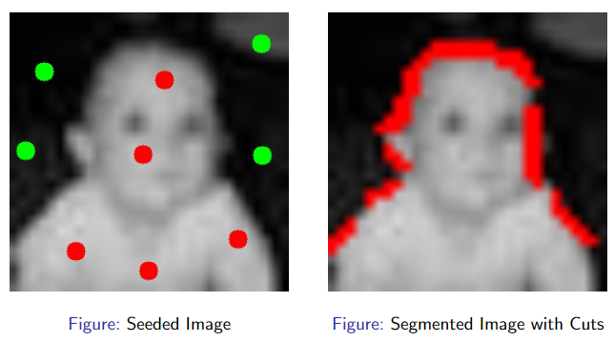
Results

Slide 8
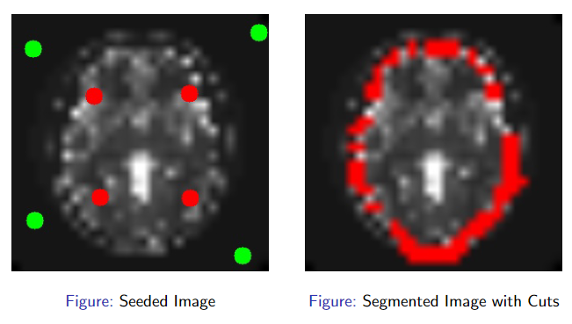
Results

Slide 9
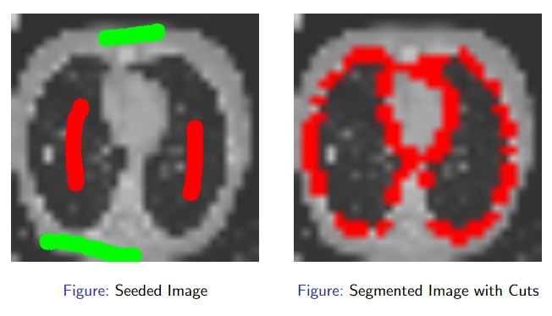
Results

Slide 10
Further Improvements

Slide 11
References
https://www.csd.uwo.ca/~yboykov/Papers/miccai00.pdf
https://link.springer.com/content/pdf/10.1007/s11263-006-7934-5.pdf

